Slide 1
ISO31000:2018 – RISK MANAGEMENT – PROCESS
A Risk Practitioners Guide To ISO31000:2018
https://www.theirm.org/media/3513119/IRM-Report-ISO-31000-2018-v3.pdf

Slide 2
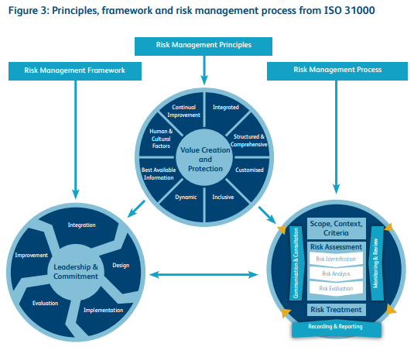
ISO31000:2018 – RISK MANAGEMENT – PROCESS

Slide 3
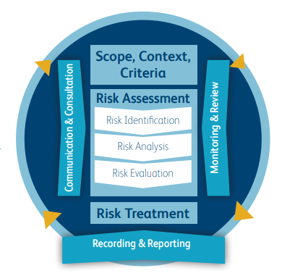
ISO31000:2018 – RISK MANAGEMENT – PROCESS
RISK
MANAGEMENT
PROCESS

Slide 4
ISO31000:2018 – RISK MANAGEMENT – PROCESS
At the center of the risk management process are the activities of risk assessment and risk treatment.
Risk assessment is described as having the three stages of risk identification, risk analysis and risk evaluation.

Slide 5
ISO31000:2018 – RISK MANAGEMENT – PROCESS
Each of the three stages is described in detail in ISO 31000 and it provides valuable insight into how risks can be identified, how they can be analyzed in terms of likelihood and consequences and finally, how they can be evaluated in relation to

Slide 6
ISO31000:2018 – RISK MANAGEMENT – PROCESS
..the established risk criteria (risk appetite) to determine whether additional action is required.

Slide 7
ISO31000:2018 – RISK MANAGEMENT – PROCESS
Risk treatment is also a vitally important part of the risk management process and ISO 31000 provides information on the selection of risk treatment options, the preparation and implementation of risk treatment plans.

Slide 8
ISO31000:2018 – RISK MANAGEMENT – PROCESS
ISO 31000 states that the selection of risk treatment options involves balancing the potential benefits of introducing further risk treatment (controls) against the associated cost, effort or disadvantages.

Slide 9
ISO31000:2018 – RISK MANAGEMENT – PROCESS
The risk treatment plan should clearly identify the timescale and responsibilities for implementing the selected risk treatments.
END

